Slide 2
Contents
I) Significant events | 3-6
II) Financial results | 7-14
III) Implemented strategy | 15-17
IV) Implemented investments | 18-22
V) Planned investments | 23-26
VI) Sales policy | 27-30
2
Notes:
2

Slide 3
I
Significant events
3
Notes:
3

Slide 4
Significant events in Q1 2012
Completion of a plot purchase at Kasprzaka Street in Warsaw
Acquisition of right of perpetual usufruct of land plots with ownership of the buildings erected on them, located in Warsaw at Kasprzaka 29/31 Street with a total area of ​​81,185.00 m² for the amount of PLN 155 million net (PLN 157,614,085 gross)
Real estates introduced to the sales:
Villa Campina in Ożarów Mazowiecki and Oazy Piątkowo in Poznań
Number of undeveloped plots: 194
Area of undeveloped plots: 162.058m2
Estimated value of utilized plots: PLN 123 mil
Ready show houses: 12 (value of PLN 19 million)
Number of flats: 183
UFS: 9,423 m2
Estimated value: PLN 60 mil
Completion of construction of the hotel complex Czarny Potok Resort & Spa in Krynica Zdrój.
4

Slide 5
Prizes and awards received in H1 2012
Prizes and awards received in H1 2012, for example:
J.W. Construction - the biggest developer in the crisis period in Central-East Europe
The CIJ Magazine released the ranking of 50 developers in Central-East Europe, which handled with the market slowdown in 2008-2012 in the most successful way. J.W.Construction took the first place with a number of
5,673 flats commissioned within the period of crisis.
Golden Statuette POLISH HERCULES 2011 in the category: POLISH PROPERTY DEVELOPER
JW Construction Holding S.A. and Józef Wojciechowski Chairman of Supervisory Boardfor outstanding achievements in the development of the construction industry in Poland, development and well established Company's position, innovative offer for a residential sector and for the effective management of the company.
5

Slide 6
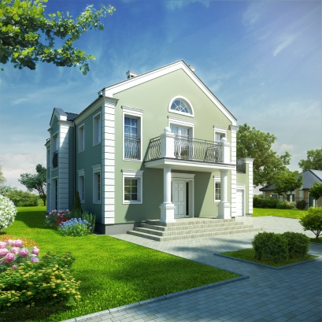
TheCompany's resultsin Q1 2012
about PLN 50 mil
The value of credits granted for investment
projects
347
units sold to customers
8
Ongoing housing investments
(including „Oxygen” project realized by J.W. Construction S.A.)
1
Commenced housing investments: - Oaza Piątkowo – Poznań
Ongoing commercial investments, including:
an office building Hanza Tower- Szczecin;
- Hotel Stara Dana - Szczecin
Hotel Czarny Potok in KrynicaZdrój
a luxurious guest house in Sopot
4
3
Investments to launchin 2012/13:
Gdynia, at Powstania Wielkopolskiego Street - a building permit
Katowice, at Tysiąclecia Street - a building permit
Miasteczko Kasprzaka
6
Notes:
6

Slide 7
Financial results
II
7

Slide 8
Sales of apartments in H1
2012 vs H12011
In H1 2012, J.W. Construction Holding S.A sold 347units*
Other investments planned to launch with sales are in the pipeline
* including 30 units from "Oxygen" investment
8
Notes:
8

Slide 9
Financial results for H12012
Revenues from sales [PLN mil]
Gross margin on sales [%]
28.94%
1,77 p.p.
Decrease in revenues from sales in H12012 by 28.94% y/y
A slight decrease in gross margin on sales in H12012 by 1,77 p.p. in relation to H1 2011
9
Notes:
9

Slide 10
Financial results for H12012
Profit from operating activities [PLN mil]
Net profit [PLN mil]
14.83%
65.18%
A decreaseinoperating profitin H12012 by14,83% in relation toH1 2011
The decrease in net profit in H12012 by 65.18% y/y
10
Notes:
10

Slide 11
Financial results inQ2 2012
Revenues from sales [PLN mil]
Gross margin on sales [%]
16.97%
0,77p.p
The increase in sales revenues in Q22012 by 16,97% in relation to Q2 2011
Maintaining the level of gross margin on sales in Q22012 r. A slight decrease by 0,77 p.p in relation to Q2 2011
11
Notes:
11

Slide 12
Financial results inQ2 2012
Profit from operating activities [PLN mil]
Net profit [PLN mil]
87.18%
12.96%
The increase in operating profit inQ22012 by 87,18% y/y
The increase in net profit inQ2 2012 by 12,96% in relation to Q2 2011
12
Notes:
12

Slide 13
Implementation of the gross profit from sales in H12012
The level of gross profit earned from sales in H1 2012 is PLN 43.65 mil. The percentage of developer projects recognized in profit from sales:
Units recognized in results in H1 2012 vs H1 2011:
13
Notes:
13

Slide 14
Premises from an offer for recognition in results
of subsequent quarters
* in units
14
Notes:
14

Slide 15
III
Implemented strategy
15
Notes:
15

Slide 16
Diversification of income sources
COMMERCIAL SEGMENT
J.W. CONSTRUCTION HOLDING S.A.
HOUSING SEGMENT
Zegrze
Stryków
Cieszyn
Tarnowo
Łódź
1. Centrum I & II
2. Górczewska Park
3. Osiedle Światowida
4. Lewandów Park
5. Zielona Dolina
6. Os. Bursztynowe
7. Villa Campina 8. Oaza Piątkowo
2* & 3*
Hotel 500 chain
Warsaw
Hotels
4* & 5*
1. Czarny Potok
2. Hotel
Krynica Zdroj
Szczecin
Ożarów Maz
Poznań
Popular *
Flats
Warsaw
OXYGEN
Apartments
Hanza Tower
Szczecin
Office buildings
A Class
Jerozolimskie Point
Warsaw
Ożarów Maz
Villa Campina
Exclusive
Houses
prestige
location
16

Slide 17
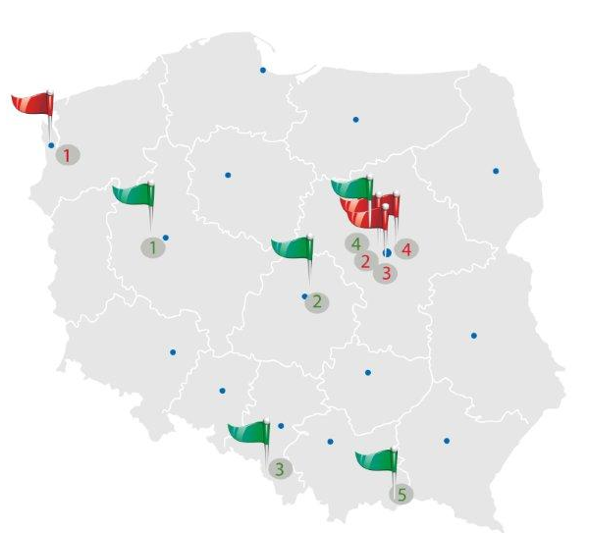
Systematic growth in the value of the Company's assets
OFFICE- SERVICESEGMENT
1. Szczecin: Hanza Tower
2. Warsaw: Jerozolimskie Point
3. Warsaw:, at Pileckiego Street
4. Warsaw: Kasprzaka office-service part
The target estimated value
is PLN 1.1 bil
HOTEL CHAIN
1. Tarnowo
2. Stryków
3. Cieszyn
4. Zegrze
5. Krynica Zdroj Czarny Potok
The target estimated value
is PLN 280 bil
17
Notes:
17

Slide 18
IV
Implemented investments
18
Notes:
18

Slide 19
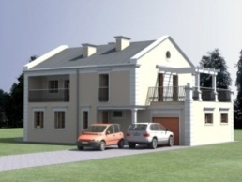
Implemented investments in H12012
HOUSING SEGMENT
Number of units
12 houses
"Villa Campina"
„Oaza Piątkowo”
„Osiedle Światowida”
"Osiedle Lewandów I"– buildings 3-6
„Osiedle Centrum II", Łódź
"OXYGEN"
"Villa Campina" blocks
"Zielona Dolina I" Zdziarska Street
UFS
2,050
„Oaza Piątkowo”
12 houses
"Villa Campina"
"OXYGEN"
19
Notes:
19

Slide 20
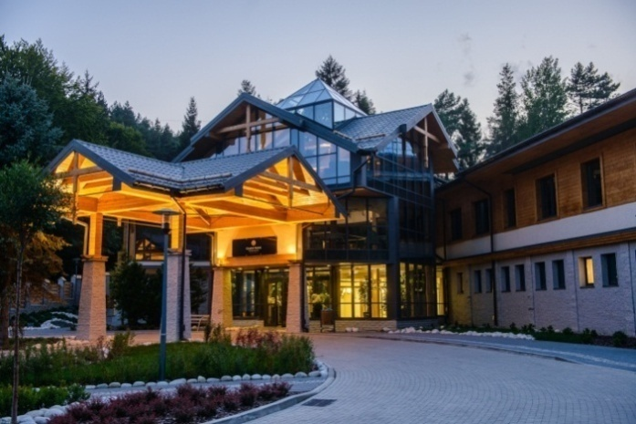
Implemented investments in H1 2012
The completion of a construction – the final preparations for the opening ofCzarny Potoku 4-star Hotel with 5-star Spa in Krynica Zdrój - Official opening - 7 September 2012
Hotelpart
231 comfortable rooms,including:
173 rooms of Classictype
14 rooms of DeLuxetype
40 Junior Suite apartments
2 SuperiorSuite apartments
2 Presidentialand Vice Presidential Suite apartments.
4 restaurants: Chopin, Paderewski, Kiepura, RegionalRestaurant
VIP-Piano Room,
Fireplaceroom - J. W. Club,
Lobby Bar
NikifiorMusic club,
20
Notes:
20

Slide 21
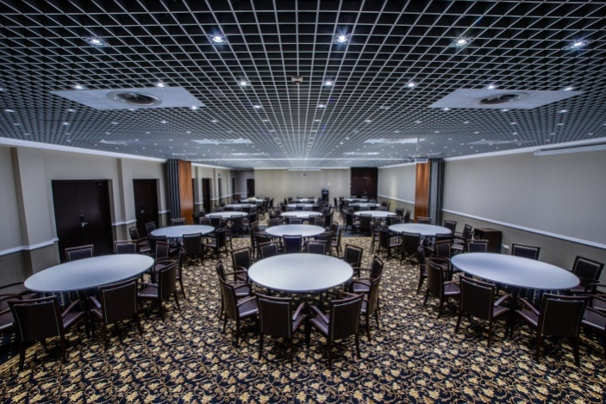
Implemented investments in H1 2012
CONFERENCE PART
The biggestconference centerinthe region
• The potential fororganization of events for a total of 500 people.
Conference roomsarea600 m².
• Modular conference rooms equipped with high-tech class audio-visual system, and an innovative control system that allows for conducting trainings, multimedia presentations, presentation and projection.
• Nubis Conferenceroom: 208 people in a theatre settlement, divided into 4 modules: Cirrus, Stratus, Cumulus i Caligo.
• Jan III Sobieski Conferenceroom: 86 people in a school settlement, divided into 3 modules: Vien, Chocim and Komorno.
• Kwiatowa Conferenceroom: 224 seats in a theatre settlement and 120 seats in a school settlement, divided into 2 modules: Crocus and Violet
21
Notes:
21

Slide 22
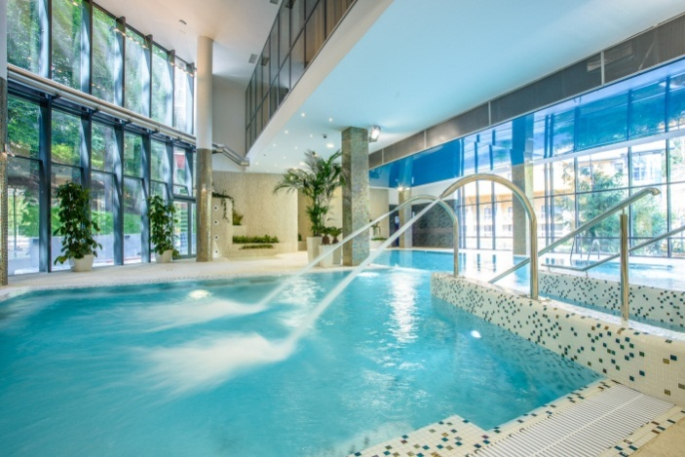
Implemented investments in H1 2012
Wellness &SPA Center
4 -level SPA & Wellness Center,
We offer: swimming pool, children's pool, jacuzzi, saunas,
VIP-SPAzone,
Proffessional SPA treatments and massages,
Sportsand Fitness,
Atrtractionsand animations for children in a professional playroom„Kids Club”.
22
Notes:
22

Slide 23
V
Planned investments
23
Notes:
23

Slide 24
Plannedprojects to commence
In the nearest 2 years, the Company is planning to introduce to its offer about 6,431units from the owned land bank, of which 24% will be erected beyond Warsaw Area of planned projects is nearly330 thousand m2
HOUSING SEGMENT
Investments in Warsaw and vicinity
Investments beyond Warsaw
Investment | Number of flats: | UFS
Warsaw, at Kasprzaka Street | 3,000 | 148,974 m2
Warasaw, Zielona Dolina II | 853 | 37,219 m2
Warsaw, at Berensona Street | 259 | 11,875 m2
Warsaw, at Antoniewska Street | 255 | 14,515 m2
Warsaw, Aluzyjna II | 147 | 6,985 m2
Warsaw, at Odkryta II | 82 | 4,158 m2
Warsaw, at Zdziarska III | 52 | 2,256 m2
Warsaw, at Aluzyjna I | 40 | 2,011 m2
Ożarów Mazowiecki (houses) | 50 | 7,500 m2
Warsaw, at Lewandów Street (houses) | 16 | 2,510 m2
Total: | 4,754 | 238,003 m2
Investment | Number of flats: | UFS
Katowice, at Tysiaclecia Street | 585 | 27,657 m2
Gdynia, at Spokojna Street | 440 | 33,500 m2
Katowice, at Bałtycka Street | 263 | 15,688 m2
Łódź, at Tymienieckiego Street III | 106 | 5,165 m2
Gdynia, at Sochaczewska Street | 55 | 3,400 m2
Gdynia, at Powstania Wielkopolskiego Street | 52 | 3,200 m2
Total: | 1,501 | 88,610 m2
*
Investments which are to be commenced in 2012/13 are in green colour
24
Notes:
24

Slide 25
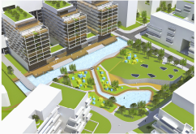
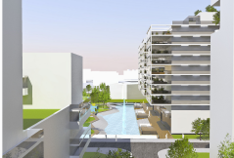
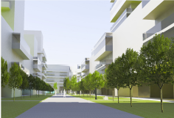
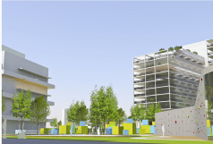
Multifunctional Miasteczko Kasprzaka
Residential complex with easy access to residential services - nursery schools, kindergartens, commerce, post offices, catering, recreation for children and adults.
Clear gradation of green outer space:
Public spaces - recreation and sports areas for all people, surrounded with green park area along water axis extending Jana Kaziemierza Street
Semi-private spaces - equipped with green, playgrounds, green squares up to the green roof gardens
Private spaces - gardens, terraces for users of individual residential units
25
Notes:
25

Slide 26
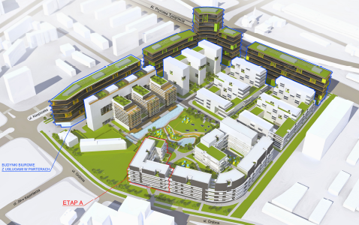
Multifunctional Miasteczko Kasprzaka
HOUSING SEGMENT
COMMERCIAL SEGMENT
Estimated value:
PLN 1.5 bil
3,000 flats, for almost 10 thousand people:
Staging
Very good location - just 3km to the city centre
In the close area, there are many transport nodes
about 70 thousand m2 for commercialfunctions:
Shopping mall: modernand intimate spaces
Entertainment
Cinema
26
Notes:
26

Slide 27
VI
Sales policy
27
Notes:
27

Slide 28
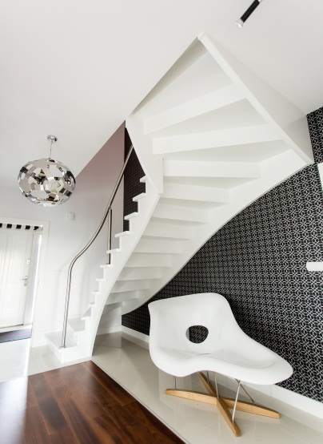
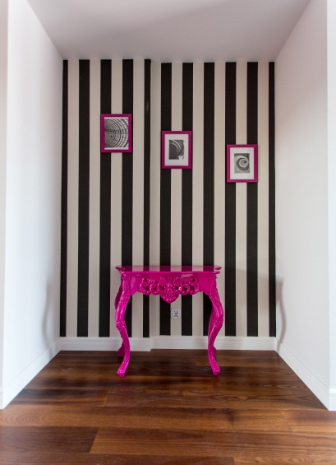
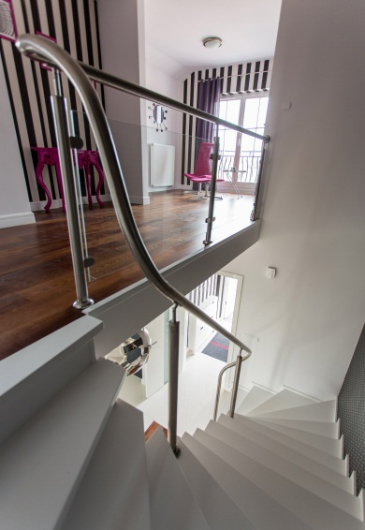
Sales policy of the Company in 2012
An attractive housing offer, including turnkey apartments, turnkey apartments with full equipment and Premium products - Villa Campina and Oxygen Apartments
Interior design programs for Clients available at the Interior Design Development Center - Silver, Gold, Platinum; Black, White, Cappucinno and Smart
Implementation of the credit program to finance a property purchase LOKUM
Professional and free of charge credit counseling
28
Notes:
28

Slide 29
Sales policy of the Company in 2012
Long-term cooperation with banks– the best offer of credits on the market of mortgages only for the Company’s customers.
Attractive offer of flats that meet the requirements of the government program "Rodzina na swoim"
Individual approach to the customer – the possibility of negotiating the prices depending on the payment amount and schedule
Packages offering special conditions, dedicated to employees of institutions co-operating with J.W. Construction Holding S.A.
Neighborhood sales program
Contest of tenders made by Customers
Special offer for customers on the occasion of the Company's participation in the fair trade and during the organization of open days of house estates
29
Notes:
29

Slide 30
Sales policy of the Company in 2012
Conducting strategic marketing activities in all areas of communication with Clients
Implementation of marketing and sales program under the "LifeElevated" slogan to improve the quality of service before and after sales, and strengthening a positive image of the Company and its offer through the following actions:
- enhancing the quality and standard of investment by including additional services and facilities to the offer (e.g concierge service)
- improvement of marketing materials
- gradual training of a sales team.
30
Notes:
30

Slide 31
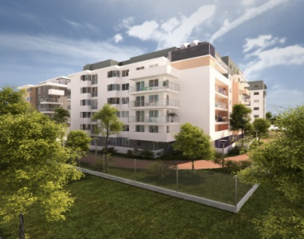
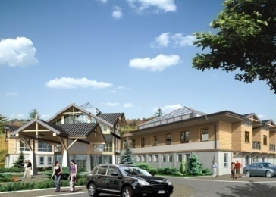
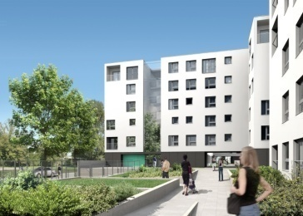
Investor Relations:
Małgorzata Szwarc-Sroka
Economy Division
and Investor Relations Office HeadDirector of Economic and Director of Investor Relations J.W Construction Holding S.A.
Member of Management Board of J.W Construction S.A.
phone: 22 771 77 85
e-mail.: relacje.inwestorskie@jwconstruction.com.pl
31
Notes:
31

